Slide 1

Azure Management from any Platform using PowerShell One Codebase to Rule Them All
Jessica Deen
Technical Evangelist - Microsoft
www.jessicadeen.com | @jldeen Jessica.Deen@Microsoft.com

Slide 2
MEET THE TEAM
Daniel Egan
Technical Evangelist
Livi Erickson Technical Evangelist
Andrew Moll
Technical Evangelist
Doris Chen Technical Evangelist
John Alioto
Principal Technical Evangelist
Tim Reilly Technical Evangelist
Tobiah Zarlez Technical Evangelist
Jeremy Foster Technical Evangelist
Tierney Wixted Community Evangelist
Beth Massi Program Manager
Annie Bubinski Community Evangelist
Jennelle Crothers Technical Evangelist
Robin Shahan Content Developer
Shaina Houston
Director of Community Evangelism
Joe Shirey
Director of Technical Evangelism
Jessica Deen Technical Evangelist
Justin Chizer
Microsoft Student Partner
Yesenia Alvarez
Community Evangelist

Slide 3
MEET THE TEAM
Daniel Egan
Technical Evangelist
Livi Erickson Technical Evangelist
Andrew Moll
Technical Evangelist
Doris Chen Technical Evangelist
John Alioto
Principal Technical Evangelist
Tim Reilly Technical Evangelist
Tobiah Zarlez Technical Evangelist
Jeremy Foster Technical Evangelist
Tierney Wixted Community Evangelist
Beth Massi Program Manager
Annie Bubinski Community Evangelist
Jennelle Crothers Technical Evangelist
Robin Shahan Content Developer
Shaina Houston
Director of Community Evangelism
Joe Shirey
Director of Technical Evangelism
Jessica Deen Technical Evangelist
Justin Chizer
Microsoft Student Partner
Yesenia Alvarez
Community Evangelist

Slide 4
MEET OUR MVP/RDs
Jeremy Clark
Visual Studio and Dev Tech
David McCarter
Visual Studio and Dev Tech
Vishal Saxena
Microsoft Azure
Paul Hacker
Visual Studio and Dev Tech
Mathias Brandewinder
Visual Studio and Dev Tech
Deborah Kurata
Visual Studio and Dev Tech
Ward Bell Windows Development
Craig Berntson
Visual Studio and Dev Tech
Chander Dhall
Visual Studio and Dev Tech
Steve Evans
Visual Studio and Dev Tech

Slide 5
MEET OUR MVP/RDs
Jeremy Clark
Visual Studio and Dev Tech
David McCarter
Visual Studio and Dev Tech
Vishal Saxena
Microsoft Azure
Paul Hacker
Visual Studio and Dev Tech
Mathias Brandewinder
Visual Studio and Dev Tech
Deborah Kurata
Visual Studio and Dev Tech
Ward Bel
Windows Development
Craig Berntson
Visual Studio and Dev Tech
Chander Dhall
Visual Studio and Dev Tech
Steve Evans
Visual Studio and Dev Tech

Slide 6
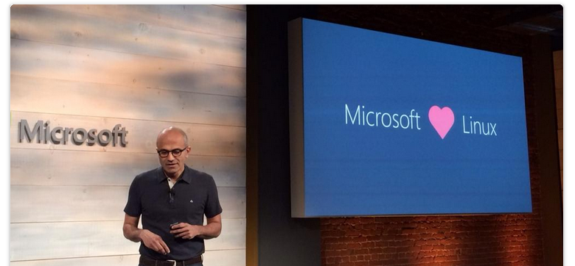
“This is not your Dad’s Microsoft.”

Slide 7

We’re Reimagining Microsoft
Our Mission
We will empower
every person and
every organization
on the planet
to achieve more
Notes:
[Script]:
Every great company has an enduring mission. We’ve challenged ourselves to think about our core mission, our soul – what would be lost if we disappeared.
We will empower every person and every organization on the planet to achieve more. We have unique capabilities in harmonizing the needs of both individuals and organizations. This is in our DNA. Perhaps “on the planet” is the most important and interesting idea in that statement. We care deeply about making a difference in lives and organizations in all corners of the planet.
Our strategy is to build best-in-class platforms and productivity services for a mobile-first, cloud-first world. Our platforms will harmonize the interests of end users, developers and IT better than any competing ecosystem or platform. We will realize our mission and strategy by investing in three interconnected and bold ambitions.
Again, doing so isn’t simply good business. It’s playing a part in the most fundamental of human activities: creating tools that enable each of us to continue our journey to become something more. In summary, we want to Empower you to achieve more!

Slide 8
Our Strategy
Build the best-in-class platforms and productivity services for the mobile-first, cloud-first world
Notes:
[Script]:
Every great company has an enduring mission. We’ve challenged ourselves to think about our core mission, our soul – what would be lost if we disappeared.
We will empower every person and every organization on the planet to achieve more. We have unique capabilities in harmonizing the needs of both individuals and organizations. This is in our DNA. Perhaps “on the planet” is the most important and interesting idea in that statement. We care deeply about making a difference in lives and organizations in all corners of the planet.
Our strategy is to build best-in-class platforms and productivity services for a mobile-first, cloud-first world. Our platforms will harmonize the interests of end users, developers and IT better than any competing ecosystem or platform. We will realize our mission and strategy by investing in three interconnected and bold ambitions.
Again, doing so isn’t simply good business. It’s playing a part in the most fundamental of human activities: creating tools that enable each of us to continue our journey to become something more. In summary, we want to Empower you to achieve more!

Slide 9



Our Ambitions
Reinvent productivity & business processes
Build the intelligent cloud platform
Create more personal computing
Notes:
[Script]:
Every great company has an enduring mission. We’ve challenged ourselves to think about our core mission, our soul – what would be lost if we disappeared.
We will empower every person and every organization on the planet to achieve more. We have unique capabilities in harmonizing the needs of both individuals and organizations. This is in our DNA. Perhaps “on the planet” is the most important and interesting idea in that statement. We care deeply about making a difference in lives and organizations in all corners of the planet.
Our strategy is to build best-in-class platforms and productivity services for a mobile-first, cloud-first world. Our platforms will harmonize the interests of end users, developers and IT better than any competing ecosystem or platform. We will realize our mission and strategy by investing in three interconnected and bold ambitions.
Again, doing so isn’t simply good business. It’s playing a part in the most fundamental of human activities: creating tools that enable each of us to continue our journey to become something more. In summary, we want to Empower you to achieve more!

Slide 10
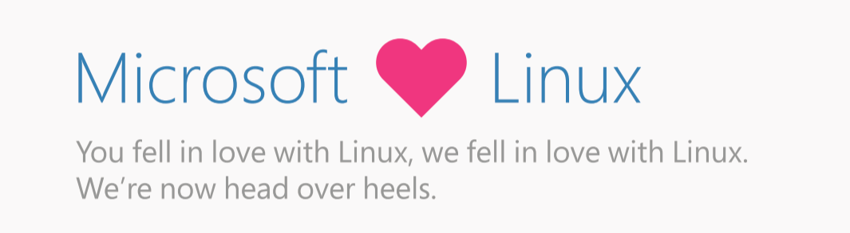



Notes:
Open source
GitHub
MIT License
Open to community development
Contributors
Committers
Refactored on .NET Core
One code base for all OSes

Slide 11
Microsoft and Open Source
Notes:
Open source
GitHub
MIT License
Open to community development
Contributors
Committers
Refactored on .NET Core
One code base for all OSes

Slide 12
Visual Studio Code .Net Core PowerShell Core
Notes:
Open source
GitHub
MIT License
Open to community development
Contributors
Committers
Refactored on .NET Core
One code base for all OSes

Slide 13
Use any client Run workloads on any server And any cloud
Notes:
Open source
GitHub
MIT License
Open to community development
Contributors
Committers
Refactored on .NET Core
One code base for all OSes

Slide 14
Enable
Notes:
Enable Linux and Open Source technology to be first class citizens on Microsoft Platforms

Slide 15
Integrate
Notes:
Integrate - Embrace leading Open Source ecosystems and integrate Microsoft products with agility and consistency

Slide 16
Release
Notes:
Release - Release key Microsoft technologies into the Open Source domain to build a strong ecosystem

Slide 17
Participate
Notes:
Participate - Microsoft engineers to participate in communities and contribute to key Open Source Projects

Slide 18














Our Approach to Open Source in the Cloud
Enable
Integrate
Release
Participate
Enable Linux and Open Source technology to be first class citizens on Microsoft Platforms
Embrace leading Open Source ecosystems and integrate Microsoft products with agility and consistency
Release key Microsoft technologies into the Open Source domain to build a strong ecosystem
Microsoft engineers to participate in communities and contribute to key Open Source projects
R Server
.NET Core
Roslyn
TypeScript
F#
autorest
PowerBI Visuals
Office UI Fabric
Tools plugins
Open Source Partners & Ecosystem

Slide 19


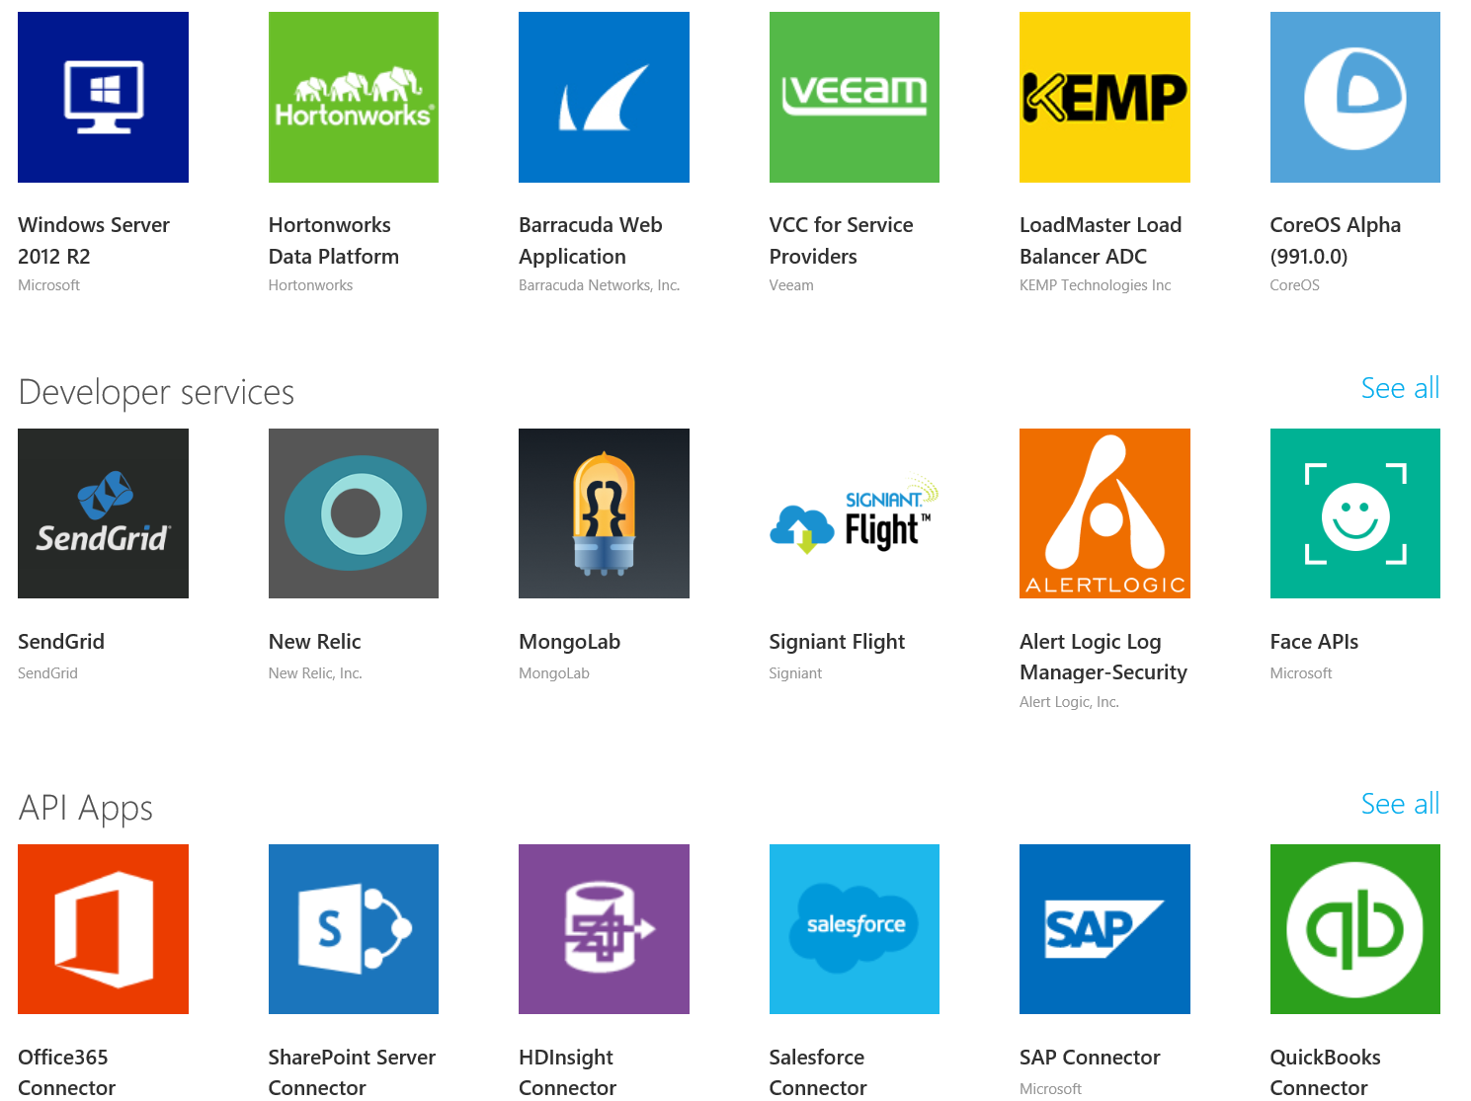


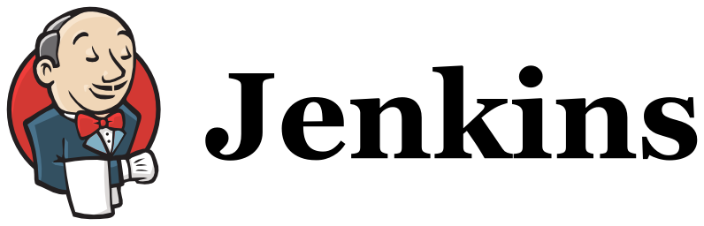


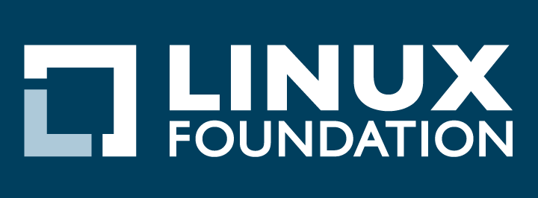


Open Source Investments are Fueling the Momentum
Our Products
Our Offerings
Azure Marketplace
60% of all images in Azure Marketplace are based on Linux/OSS
SQL Server on Linux
Acquisition
Windows Subsystem for Linux
1 out of 3 VMs on Azure run Linux, and more than half of all new VMs run Linux
C:\Users\markhill> bash
1 out of 3
HD Insight managed service on Linux
root@localhost: #
Run Linux on Windows natively
Our Partnerships
Our Employees
Ross Gardler President Apache SW Foundation
Wim Coekaerts Oracle’s Mr. Linux joins Microsoft
Partnership
Jenkins project on Azure
Partnership with the Linux Foundation for Linux on Azure certification
600 Million+
Lines of open source code submitted to GitHub by Microsoft engineers
Microsoft joins Eclipse Foundation
Microsoft Open Source Hub
Notes:
Notes coming soon – please check back on http://aka.ms/opensource for latest version

Slide 20
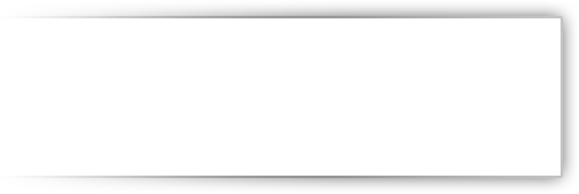


















































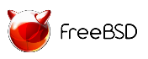





Azure: Delivering Open Source Innovation in the Cloud
Addressing Your Enterprise Cloud Needs in a Trustworthy Way
Private Cloud
Hybrid Cloud
Public Cloud
Trust In Microsoft
..... Now Across Your Entire Stack!
Management
System Center
OMS
DevOps & PaaS
Team Foundation Services
Applications
Dynamics
SharePoint
Exchange
Frameworks & Tools
.NET
Visual Studio
Data
SQL Server
Infrastructure
Windows
Server
Notes:
Notes coming soon – please check back on http://aka.ms/opensource for latest version

Slide 21
Assumptions
- Basic knowledge of Linux / Unix command line
- Current Azure subscription – 30 Day Free Trial w/ $200 credit
- Systems Administration / Network Administration Experience
Notes:
[Script]:
Every great company has an enduring mission. We’ve challenged ourselves to think about our core mission, our soul – what would be lost if we disappeared.
We will empower every person and every organization on the planet to achieve more. We have unique capabilities in harmonizing the needs of both individuals and organizations. This is in our DNA. Perhaps “on the planet” is the most important and interesting idea in that statement. We care deeply about making a difference in lives and organizations in all corners of the planet.
Our strategy is to build best-in-class platforms and productivity services for a mobile-first, cloud-first world. Our platforms will harmonize the interests of end users, developers and IT better than any competing ecosystem or platform. We will realize our mission and strategy by investing in three interconnected and bold ambitions.
Again, doing so isn’t simply good business. It’s playing a part in the most fundamental of human activities: creating tools that enable each of us to continue our journey to become something more. In summary, we want to Empower you to achieve more!

Slide 22
- Source control via GitHub - Setup VS Code - Setup desktop environment (Mac or Linux) - VS Code Integrated Terminal Demo - Azure Deployment Demo - Touch on Azure CLI
What we will cover
Notes:
Install scripts provided
Open source
GitHub
MIT License
Open to community development
Contributors
Committers
Refactored on .NET Core
One code base for all OSes

Slide 23
DEMO
Notes:
We’ve gone through a journey today, through the various capabilities of Azure that support your path toward digital transformation, from app innovation, to data and intelligence, to open and flexible deployments, to trust. We’re here to partner with you as you continue to innovate and transform. Thank you.

Slide 24
Q & A
Notes:
We’ve gone through a journey today, through the various capabilities of Azure that support your path toward digital transformation, from app innovation, to data and intelligence, to open and flexible deployments, to trust. We’re here to partner with you as you continue to innovate and transform. Thank you.

Slide 25
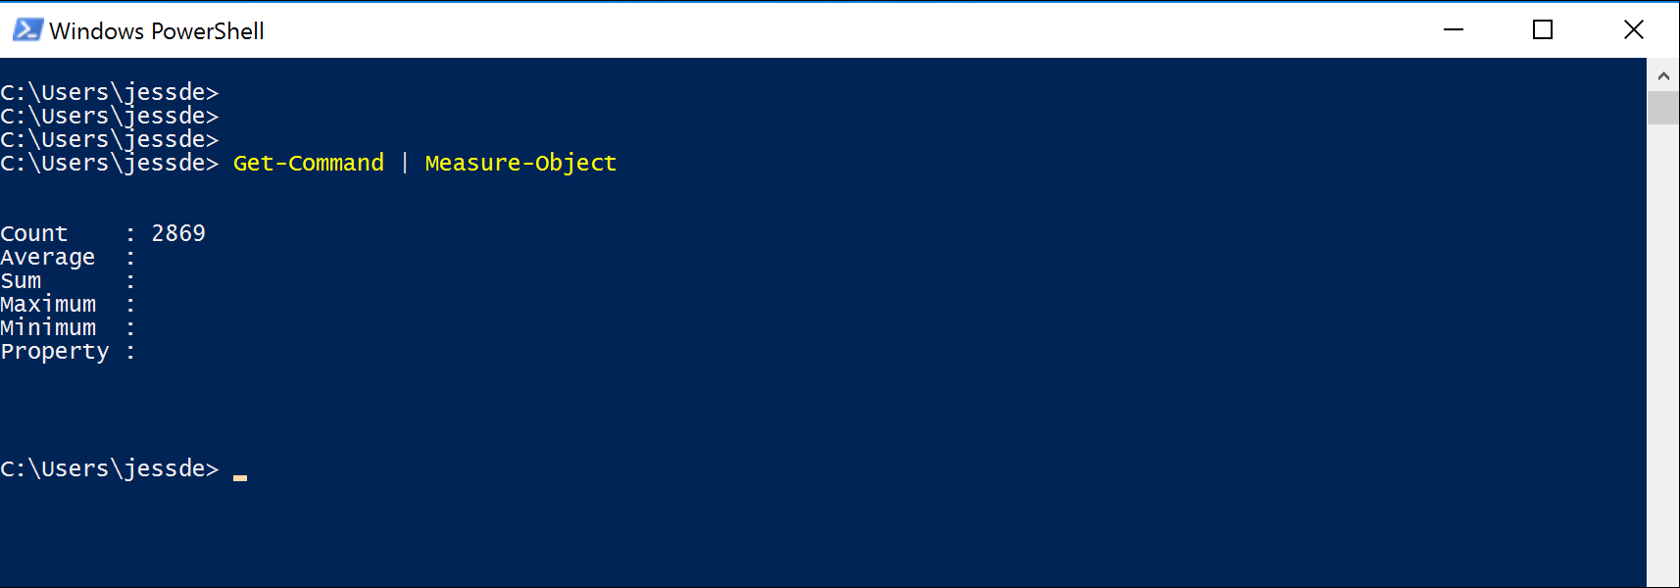
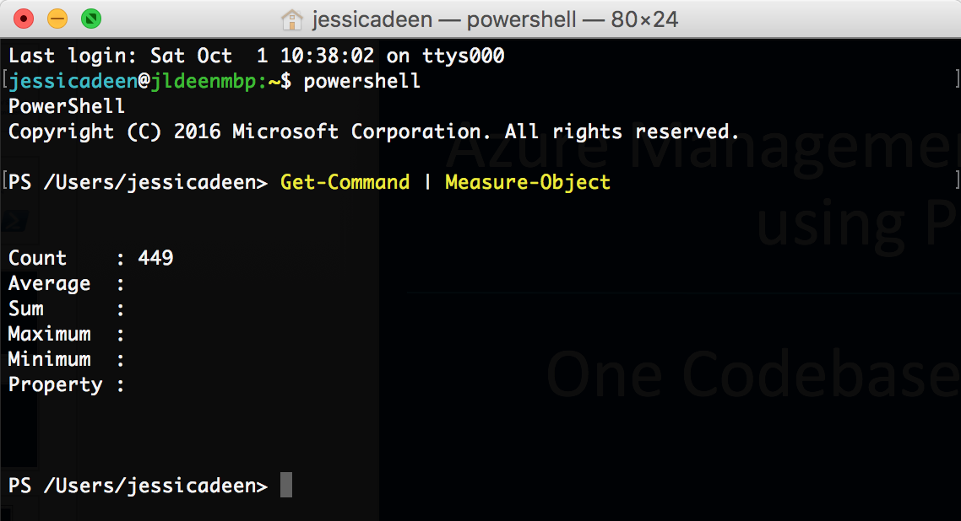

Slide 26
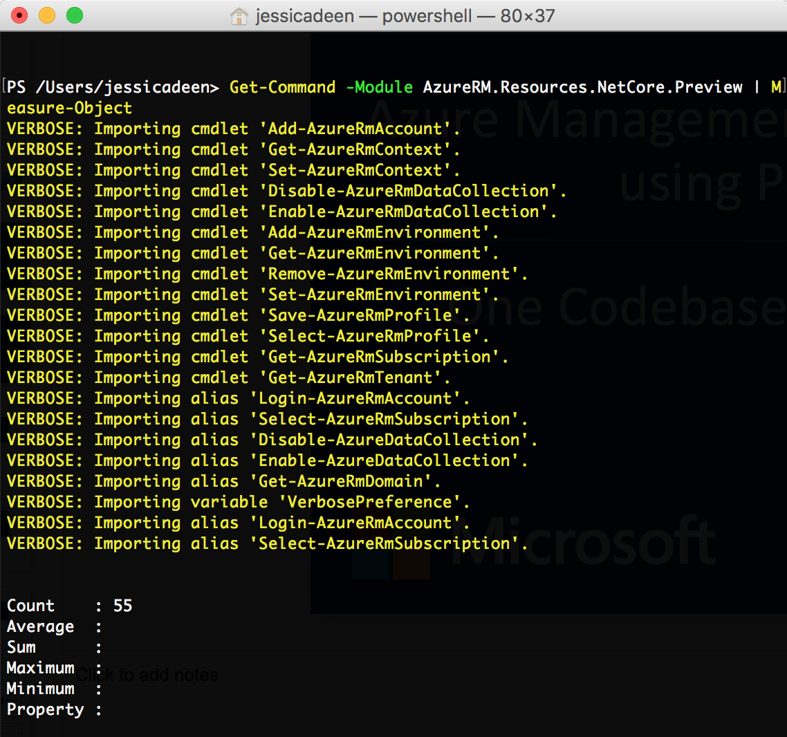
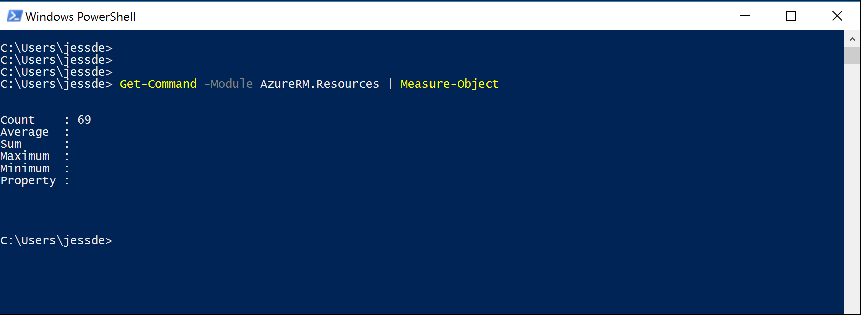

Slide 27
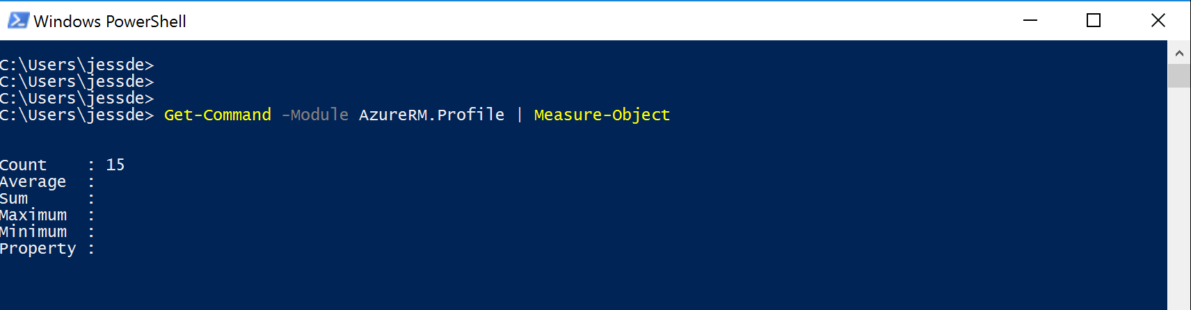
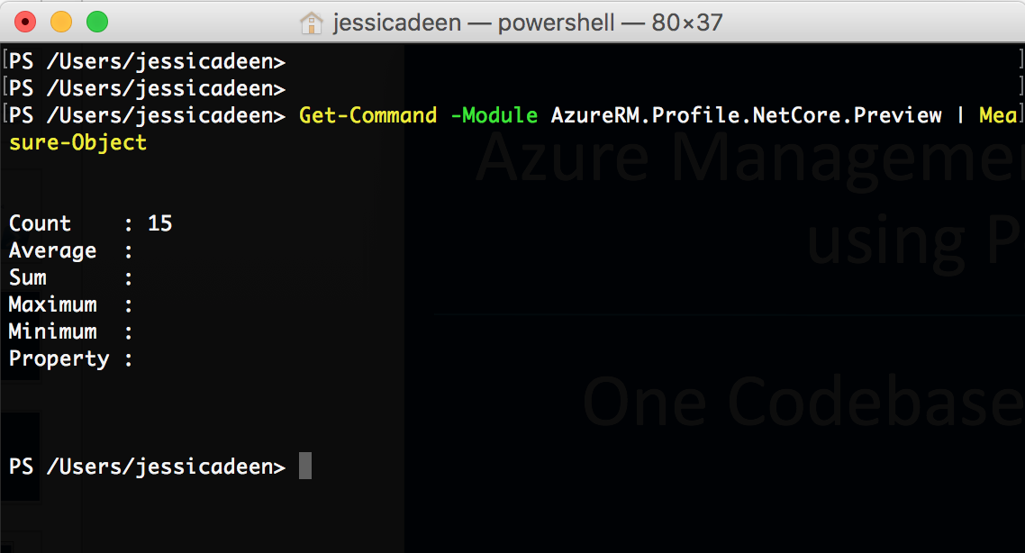

Slide 28
MAKE THE MOST OF YOUR EXPERIENCE
Complete the survey for a chance to win Beats by Dre Headphones
Survey → aka.ms/SVCC
Visit our booth
Connect with our speakers
Submit Your Session Cards
Fill out a session card to enter a raffle for a Ricoh Theta 360 camera
Microsoft Azure Essentials book giveaway for survey completion while supplies last

Slide 29
What Next?
GitHub https://github.com/jldeen/SVCC-AzureMgmtxplat
Deck
Install scripts
Deployment scripts
Settings.json file for VS Code – Ubuntu, OS X, Windows
Extras
Learn more about Azure, Cloud, OSS, Linux, PS, etc. http://jessicadeen.com/

Slide 30
Thank you
Notes:
We’ve gone through a journey today, through the various capabilities of Azure that support your path toward digital transformation, from app innovation, to data and intelligence, to open and flexible deployments, to trust. We’re here to partner with you as you continue to innovate and transform. Thank you.

